Slide 1
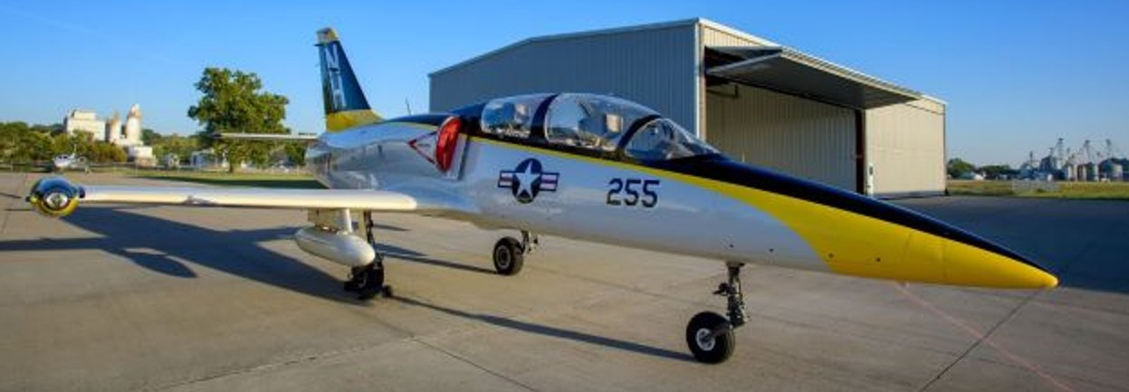

L-39ZA TOLD Calculator Instructions
OPL 2022 | Operator Performance Laboratory| University of Iowa

Slide 2
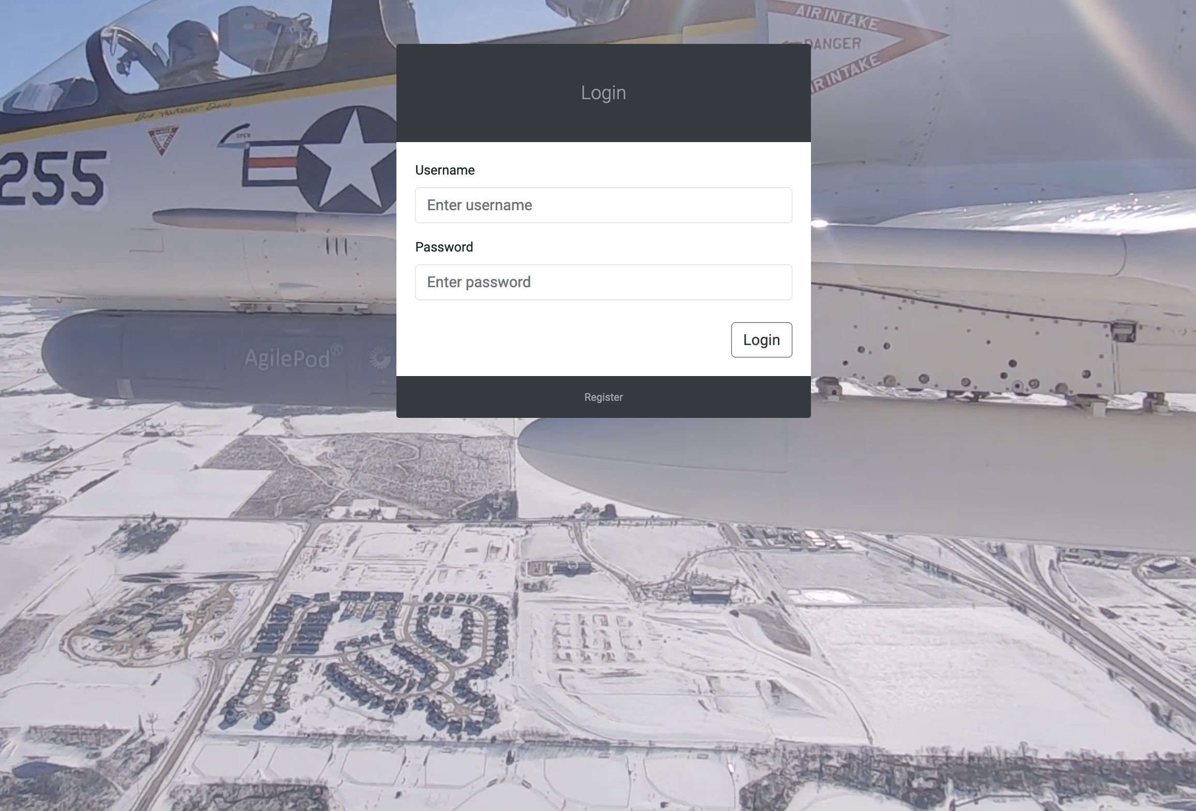
TOLD Calculator
The L-39ZA TOLD Calculator is able to calculate takeoff, landing, and stall speed parameters for the L-39ZA light attack aircraft.
The application contains 4 main functions:
Mission Parameters Calculator
Aircraft & Pilot Profile Creation, Editing, and Deletion
Maximum Fuel Capacity Solver
Automatic Query of Airport-Specific Runway Conditions
TOLD Calculator Login Page
OPL 2022 | Operator Performance Laboratory| University of Iowa

Slide 3
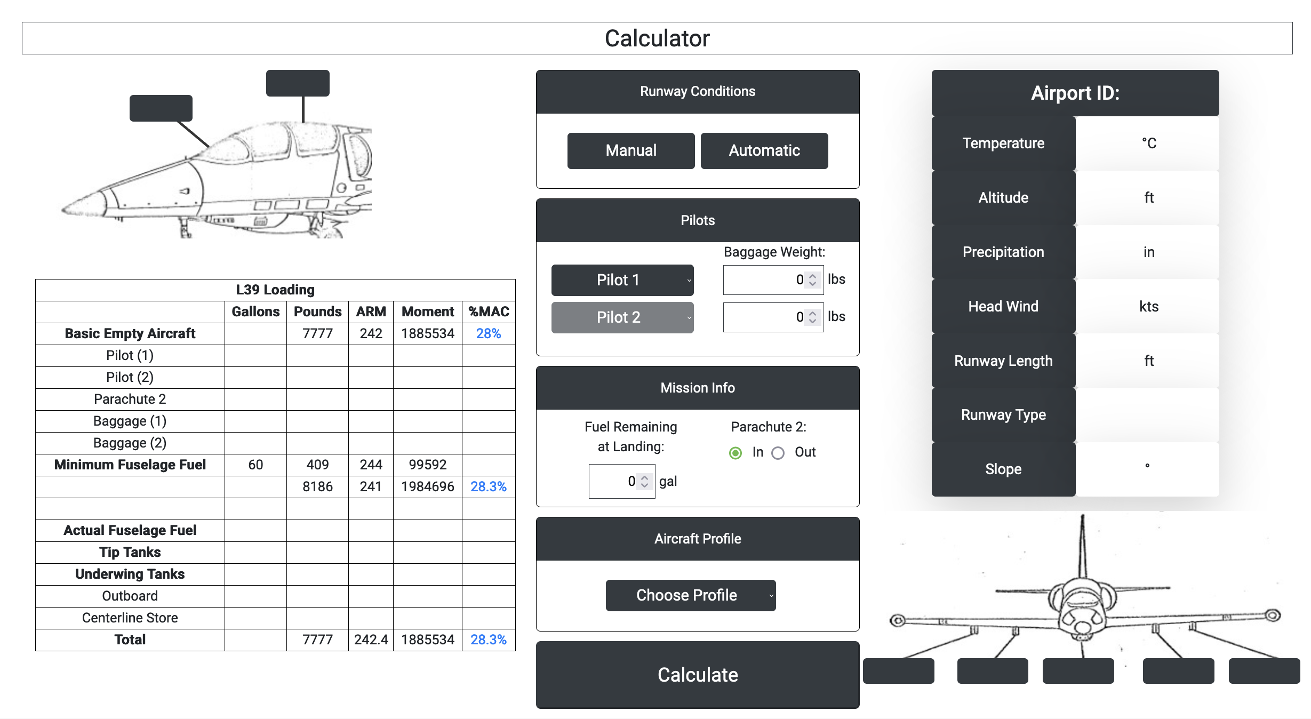
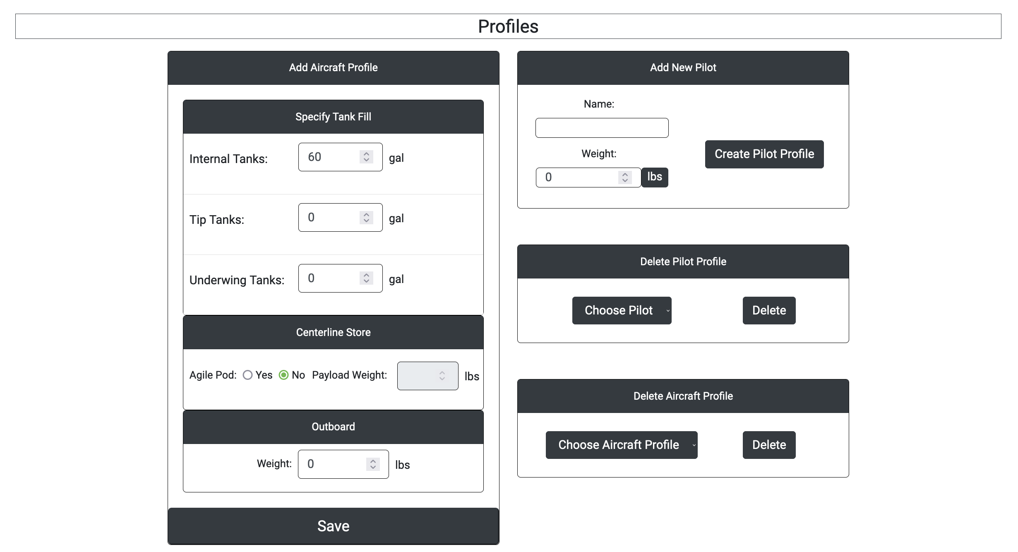
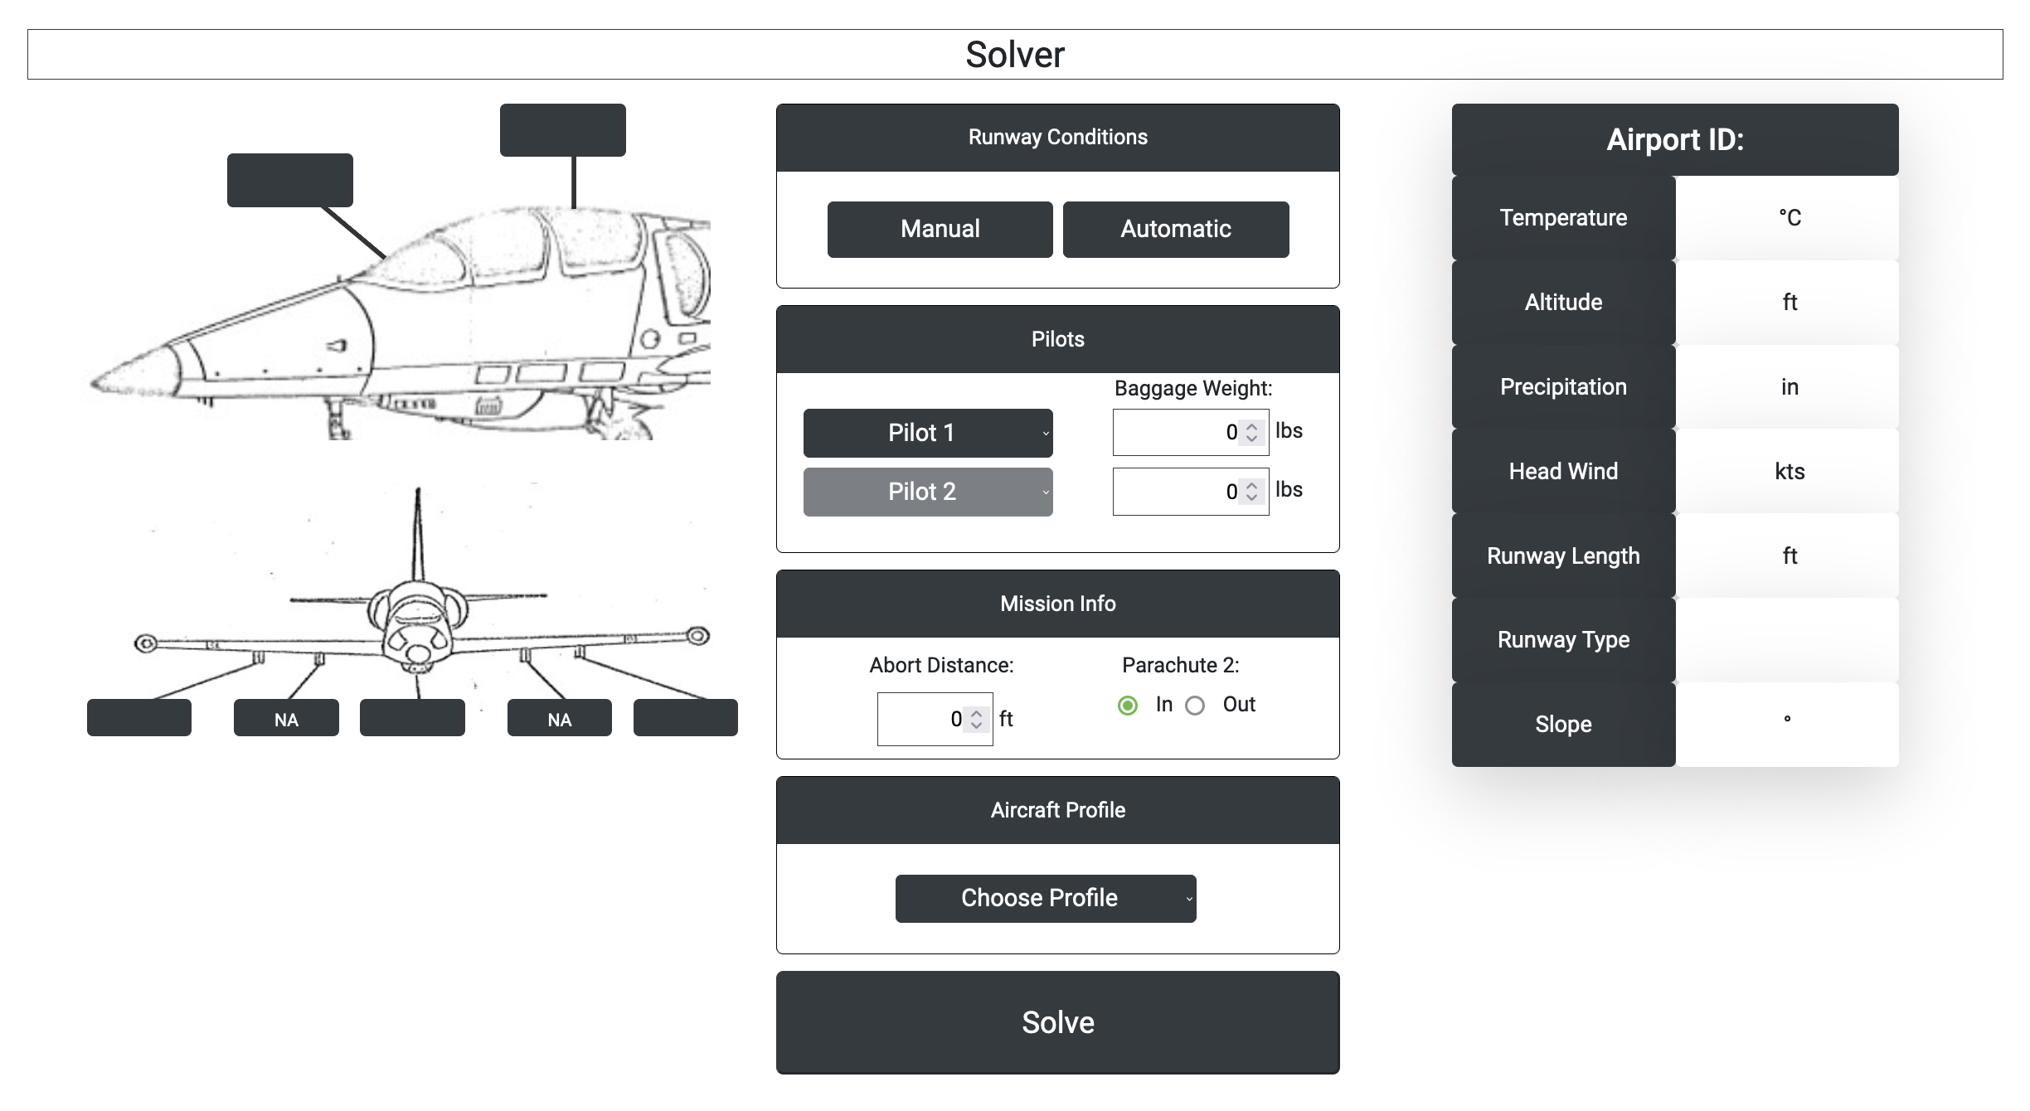
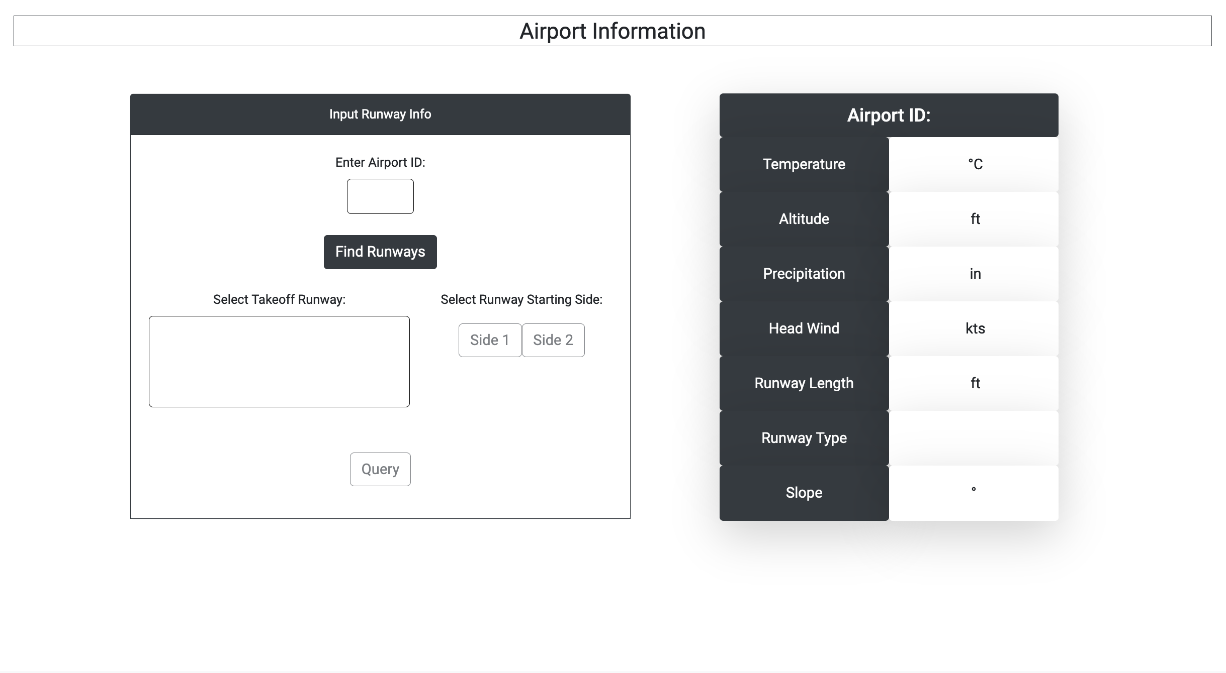
TOLD Calculator
Calculator
Calculator
Profiles
Profiles
Solver
Solver
Runway Query
Runway Query
OPL 2022 | Operator Performance Laboratory| University of Iowa

Slide 4
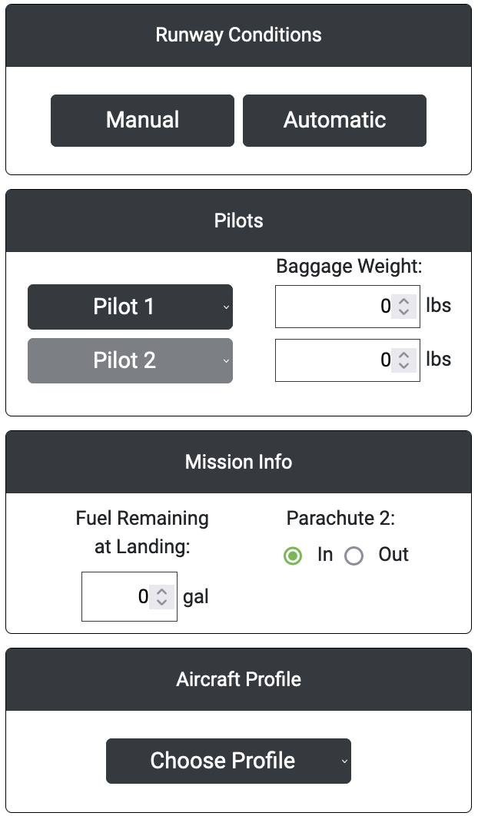
TOLD Calculator
Calculator
The calculator has 4 general inputs:
Runway Conditions
Manual entry via user input or queried from external sources
Pilot Information
Mission pilot selected from previously creation of pilot’s profile
Extra baggage of each pilot
Mission Information
Estimated fuel remaining upon landing
Optional parachute removal from the aircraft designated for a second pilot
Aircraft Profile
Previously created aircraft loadout profile
Profiles
Solver
Runway Query
OPL 2022 | Operator Performance Laboratory| University of Iowa

Slide 5
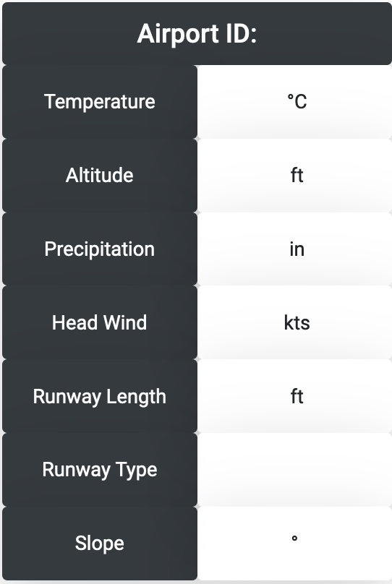
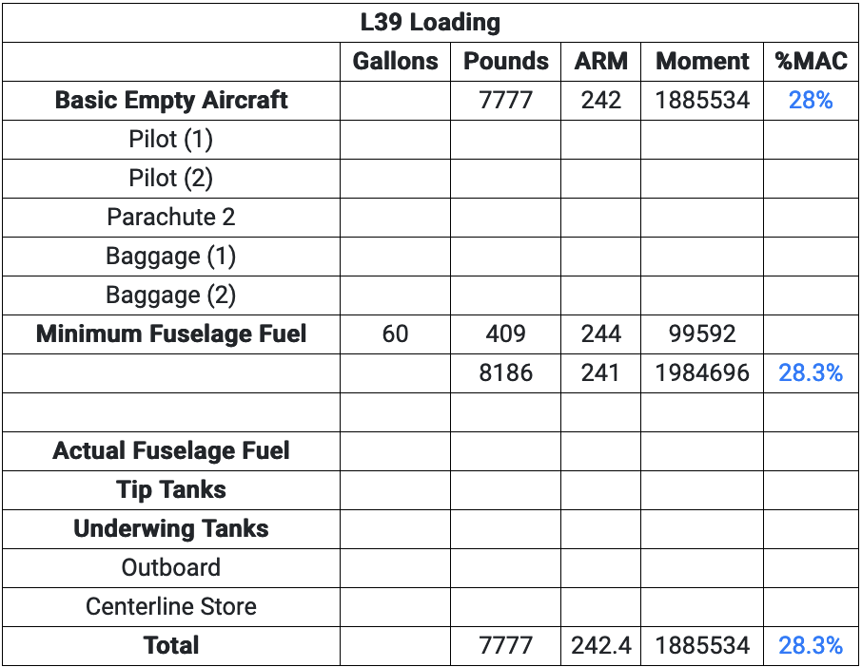
TOLD Calculator
Calculator
When runway conditions are input or queried, the corresponding information will be displayed in the table to the right
Profiles
Solver
As inputs are selected, the L-39 loading table to the left will automatically update with weight, moment, and %MAC
Runway Query
OPL 2022 | Operator Performance Laboratory| University of Iowa

Slide 6
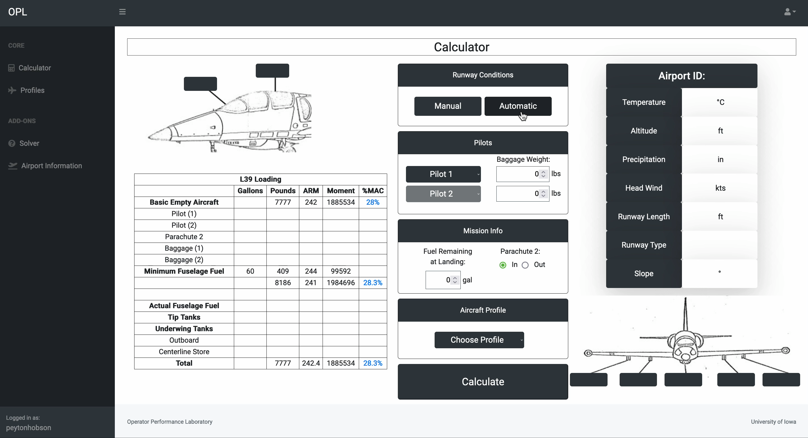
TOLD Calculator
OPL 2022 | Operator Performance Laboratory| University of Iowa

Slide 7
TOLD Calculator
Calculator
Profiles
Calculator
Profiles
Solver
Solver
Runway Query
Runway Query
OPL 2022 | Operator Performance Laboratory| University of Iowa

Slide 8
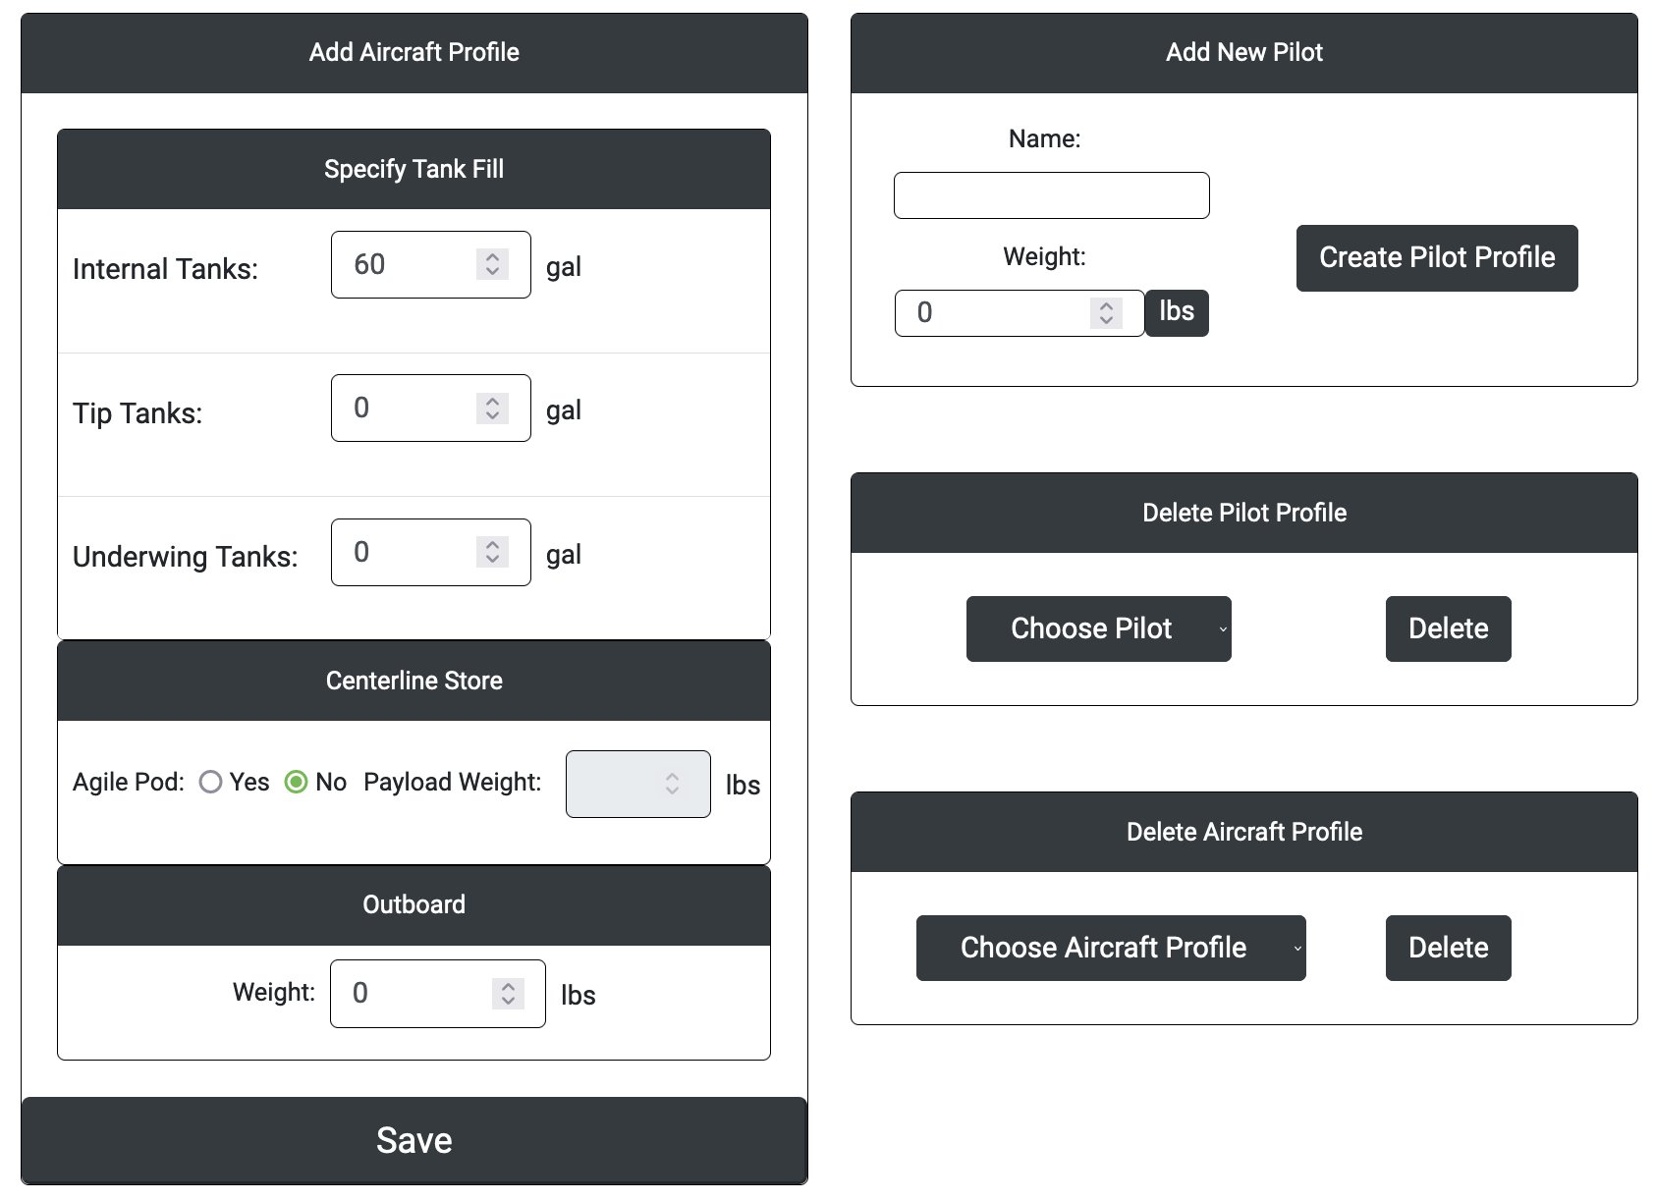
TOLD Calculator
Calculator
The Profile dashboard allows for adding/editing/deleting aircraft and pilot profiles
If a profile is created with the same name as an already existing one, the new profile will override the existing values and the new values will be saved
Profiles
Solver
Runway Query
OPL 2022 | Operator Performance Laboratory| University of Iowa

Slide 9
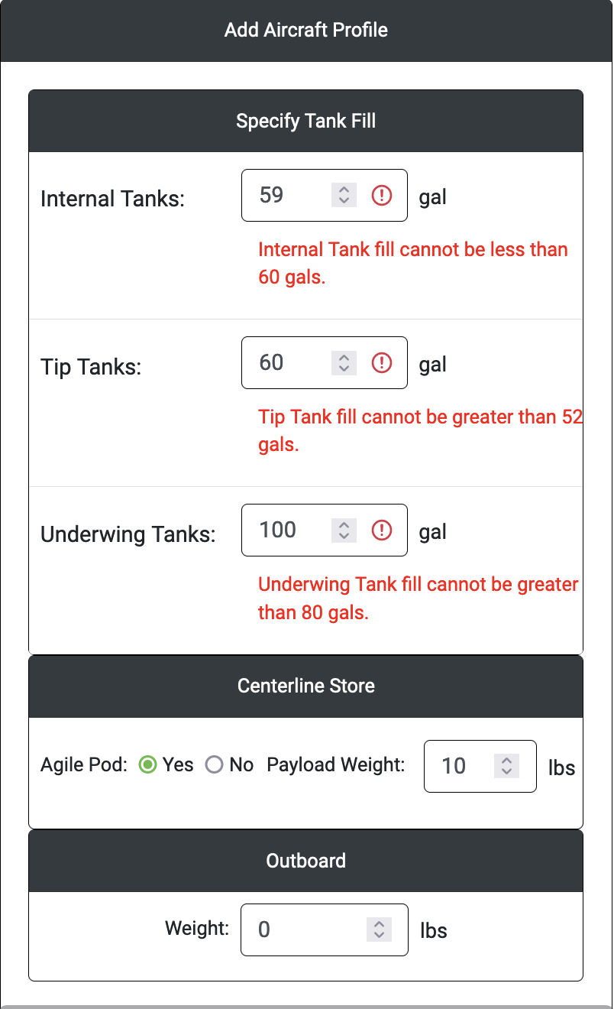
TOLD Calculator
Calculator
The minimum and maximum values for each input are as follows:
Profiles
 | Minimum | Maximum
Internal Tanks | 60 | 288
Tip Tanks | 0 | 52
Underwing Tanks | 0 | 80
Payload Weight | 0 | 150
Outboard | 0 | Inf
Pilot Weight | 0 | Inf
Solver
Runway Query
OPL 2022 | Operator Performance Laboratory| University of Iowa

Slide 10
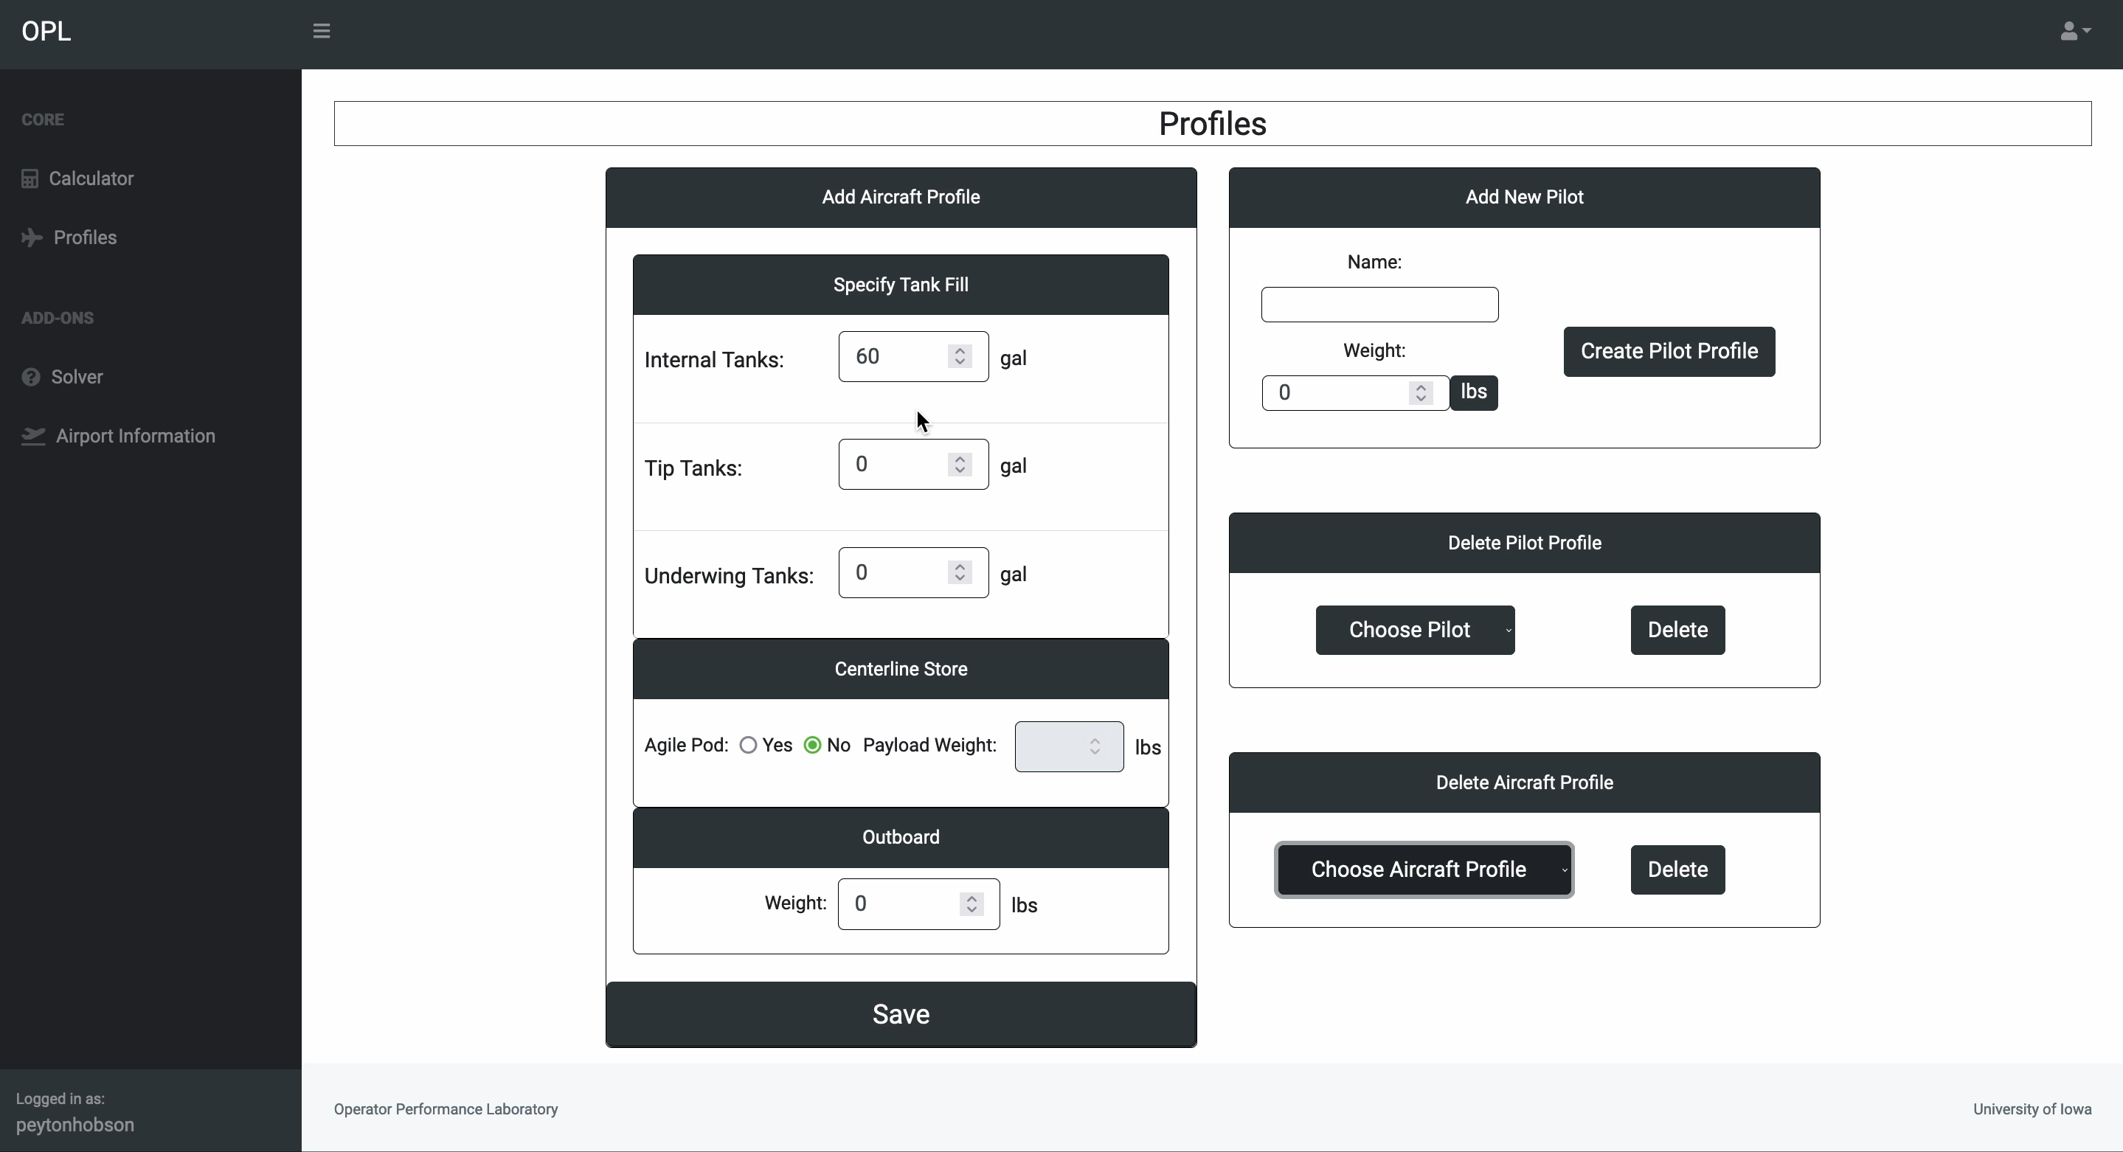
TOLD Calculator
OPL 2022 | Operator Performance Laboratory| University of Iowa

Slide 11
TOLD Calculator
Calculator
Calculator
Profiles
Profiles
Solver
Runway Query
Solver
Runway Query
OPL 2022 | Operator Performance Laboratory| University of Iowa

Slide 12
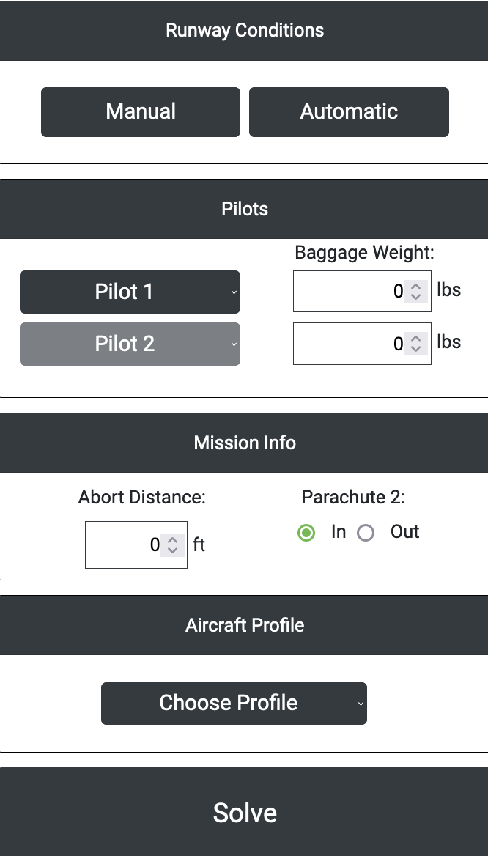
TOLD Calculator
Calculator
The Solver shares many of the same attributes as the Calculator, but the Solver calculates the maximum fuel parameters that can be used for a specified runway and abort distance rather than calculating all performance parameters from preset fuel loadouts
Profiles
Solver
Runway Query
OPL 2022 | Operator Performance Laboratory| University of Iowa

Slide 13
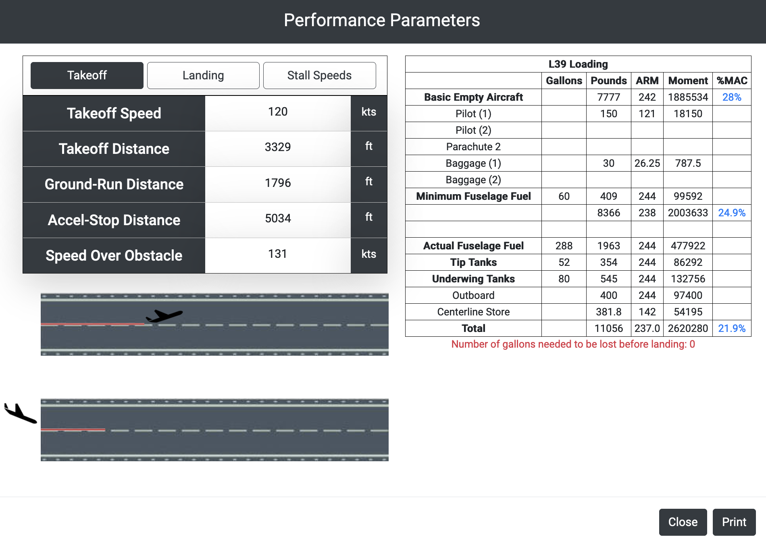
TOLD Calculator
Calculator
After clicking ”Solve,” a pop-up modal appears displaying the maximum fuel capacities which are stored in the table
The associated performance parameters are also shown
Profiles
Solver
Runway Query
OPL 2022 | Operator Performance Laboratory| University of Iowa

Slide 14
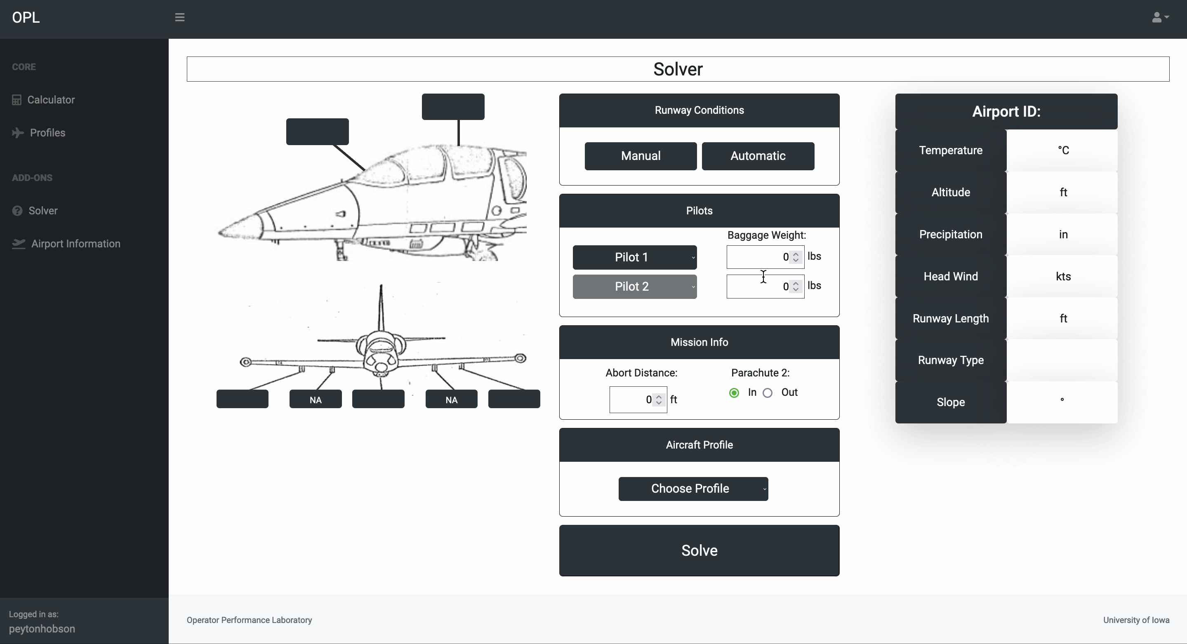
TOLD Calculator
OPL 2022 | Operator Performance Laboratory| University of Iowa

Slide 15
TOLD Calculator
Calculator
Calculating performance parameters using automatic runway queries and pre-made profiles dramatically increases user experience.
Profiles
Creating pre-made profiles reduces time when repeating calculations with similar loadouts.
Solver
Solving for maximum fuel capacity reduces the likelihood of error caused by improperly calculated weight for takeoff.
Runway Query
OPL 2022 | Operator Performance Laboratory| University of Iowa

Slide 16
TOLD Calculator
Calculator
Calculator
Profiles
Profiles
Solver
Solver
Runway Query
Runway Query
OPL 2022 | Operator Performance Laboratory| University of Iowa

Slide 17
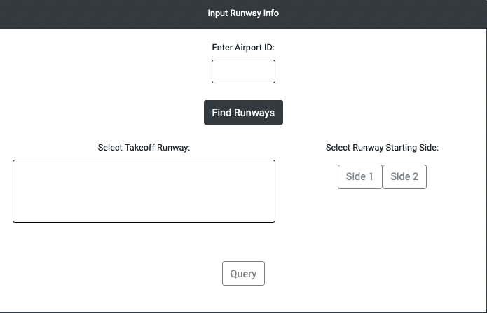
TOLD Calculator
Calculator
The Runway Query dashboard provides the user with a view of runway conditions given a specified airport ICAO ID
The query uses faa.gov for runway specific information and aviationweather.org for outputs pertaining to weather
Profiles
Solver
Runway Query
OPL 2022 | Operator Performance Laboratory| University of Iowa

Slide 18
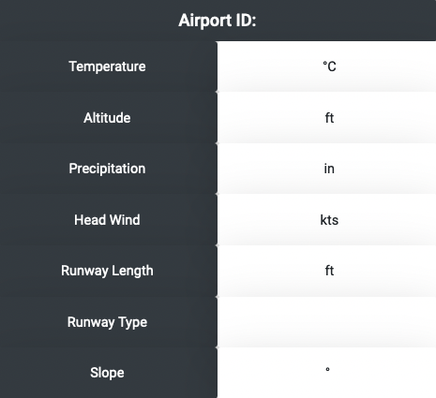
TOLD Calculator
Calculator
Profiles
Once queried, the runway conditions are displayed on the righthand side of the dashboard in the table pictured to the right
Solver
Runway Query
OPL 2022 | Operator Performance Laboratory| University of Iowa

Slide 19
TOLD Calculator - Benefits
Calculator
Calculating performance parameters using automatic runway queries and pre-made profiles dramatically increases user experience
Profiles
Creating pre-made profiles reduces time when repeating calculations with similar loadouts
Solver
Solving for maximum fuel capacity reduces the likelihood of error caused by improperly calculated weight for takeoff
Runway Query
Runway querying provides a more efficient and accurate method to obtain airport-specific weather conditions and runway information
OPL 2022 | Operator Performance Laboratory| University of Iowa

Slide 20
TOLD Calculator - Benefits
Calculator
Calculating performance parameters using automatic runway queries and pre-made profiles dramatically increases user experience
Profiles
Creating pre-made profiles reduces time when repeating calculations with similar loadouts
Solver
Solving for maximum fuel capacity reduces the likelihood of error caused by improperly calculated weight for takeoff
Runway Query
Runway querying provides a more efficient and accurate method to obtain airport-specific weather conditions and runway information
OPL 2022 | Operator Performance Laboratory| University of Iowa

Slide 21
TOLD Calculator - Benefits
Calculator
Calculating performance parameters using automatic runway queries and pre-made profiles dramatically increases user experience
Profiles
Creating pre-made profiles reduces time when repeating calculations with similar loadouts
Solver
Solving for maximum fuel capacity reduces the likelihood of error caused by improperly calculated weight for takeoff
Runway Query
Runway querying provides a more efficient and accurate method to obtain airport-specific weather conditions and runway information
OPL 2022 | Operator Performance Laboratory| University of Iowa

Slide 22
TOLD Calculator - Benefits
Calculator
Calculating performance parameters using automatic runway queries and pre-made profiles dramatically increases user experience
Profiles
Creating pre-made profiles reduces time when repeating calculations with similar loadouts
Solver
Solving for maximum fuel capacity reduces the likelihood of error caused by improperly calculated weight for takeoff
Runway Query
Runway querying provides a more efficient and accurate method to obtain airport-specific weather conditions and runway information
OPL 2022 | Operator Performance Laboratory| University of Iowa

Slide 23

Happy Flying and Safe Travels
OPL 2022 | Operator Performance Laboratory| University of Iowa

